Slide 1

Power Point for zero to hero !
Welcome to Power Point
Design principles
on slides
Headline
bullets
Say it
graphically !
Highlight
information
Animation
& speaker behavior
PROJECT
DAY 1
DAY 2
DAY 3
DAY 4
DAY 5
DAY 6
DAY 7

Slide 2
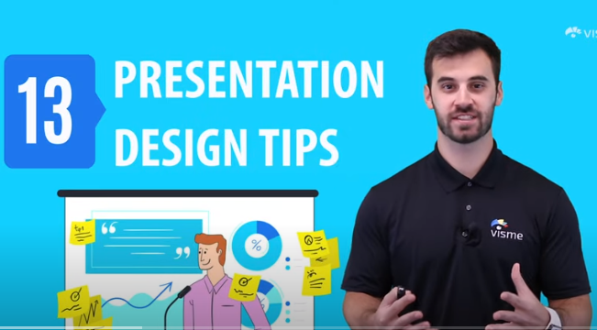

BEFORE THIS SESSION
You should have watched the below 2 videos
You should have read the below 2 article
https://www.youtube.com/watch?v=wlY65y5Dj2g
https://visme.co/blog/visual-hierarchy
https://www.youtube.com/watch?v=ZXItTIjC0Wk

Slide 3

OBJECTIVES FOR TODAY
Know the rules to design slides
Be able to improve some slides using those rules

Slide 4


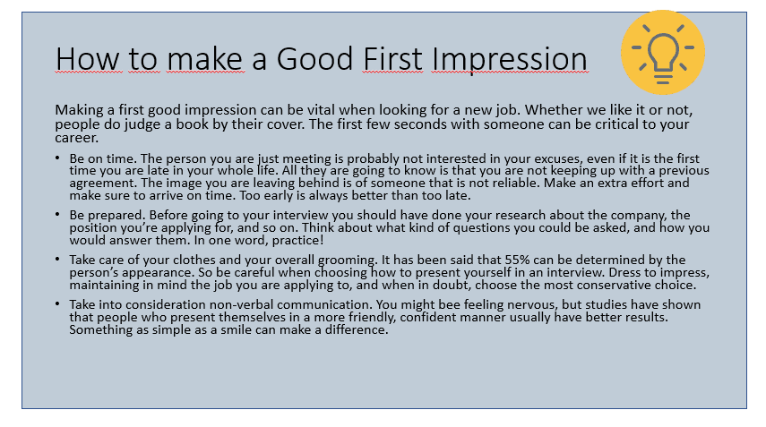
ENGAGE
Good or Bad slide ? Why ?
20 MIN
Notes:
FOR TRAINERS
More information here
https://24slides.com/presentbetter/bad-powerpoint-examples-you-should-avoid

Slide 5
SO BAD !
Too much text
No time to read
Bullets should fit in 1 line
Slides are made for the audience, not for the speaker
Notes:
FOR TRAINERS
Slides are made to complement the speaker, not to repeat word for word everything it’s being said.

Slide 6
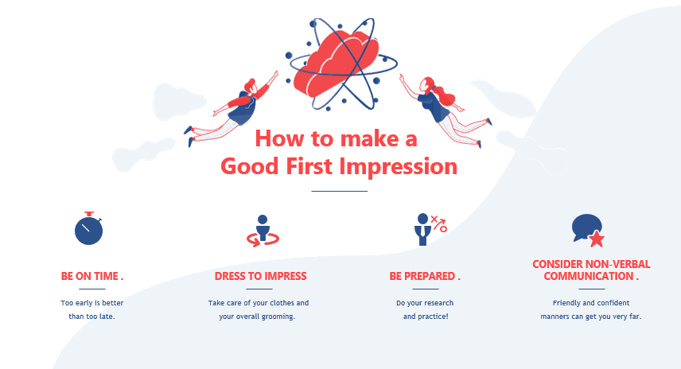
Good or Bad slide ? Why ?
Notes:
FOR TRAINERS
People are usually visually-focused
https://www.speakwithpersuasion.com/lot-of-text-on-slides/?ref=24slides.com

Slide 7
GOOD
Good hierarchy
Headline
4 main points
No bablah
Bullets are graphically displayed
Details are a bit small to see
Notes:
FOR TRAINER
Focus on keywords, in the most important concepts or ideas that you want your public to take with them.
People have limited capacity for retention,
Focusing on key points will make your presentation easier to digest.

Slide 8
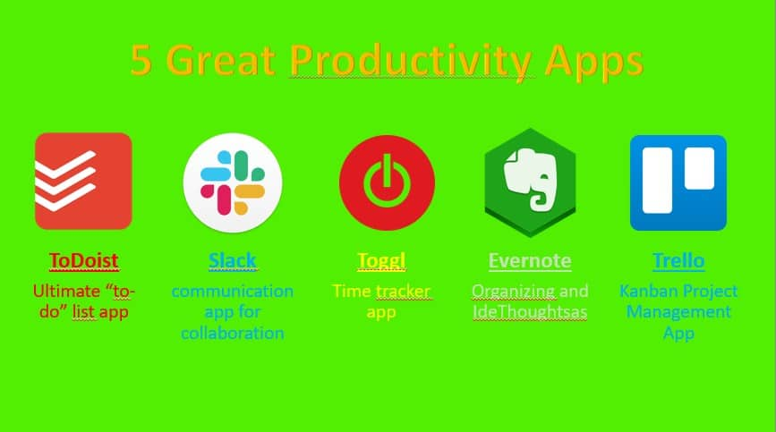
Good or Bad slide ? Why ?

Slide 9

Background and text color are NOT contrasted
SO BAD !
Rainbow style
Too many color used
Notes:
FOR TRAINERS
You can summarize the general rules of using color in just one point: make it easy to read!
1 - Contrast your colors
2 – Limit the color s
3 - Give a meaning to your colors.

Slide 10
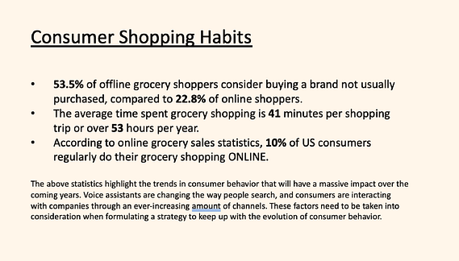
Good or Bad slide ? Why ?

Slide 11
SO BAD !
Only text is not really attractive
It doesn’t give the audience motivation to keep paying attention.

Slide 12
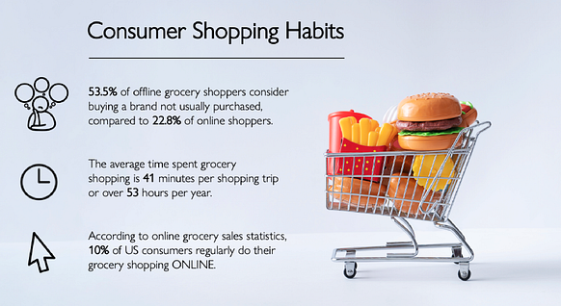
BETTER
Increate contrast with whitespace
Replace bullet with icons
Still to much things to read

Slide 13

Good or Bad slide ? Why ?

Slide 14
Text not clear !
Bad font + Bad contrast
SO BAD !
Slide should contain only 1 image
Too many information

Slide 15
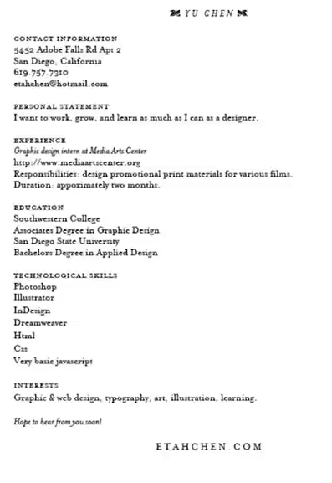
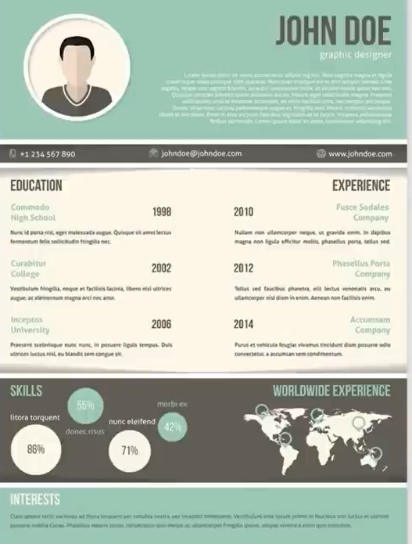
Who will get the job?
Give as much as possible reasons why the right CV is better

Slide 16
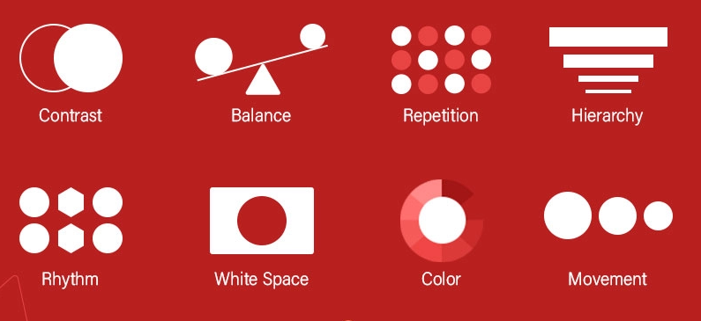
EXPLAIN
8
DESIGN PRINCIPLES
TO APPLY ON PRESENTATIONS
Notes:
FOR TRAINER
It s better to give them the slides now, to do the small activities

Slide 17
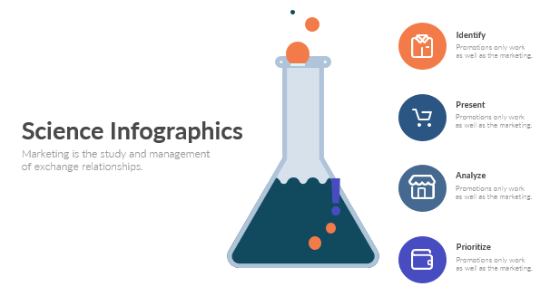
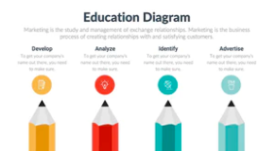
#1 Colors : 1 to 4 only
Each color should match together
Use color only when you need to contrast
You can assign a meaning to you colors

Slide 18
ACTIVITY
Tip 1 - Power point color library
Identify
Power point propose libraries of colors
From this slide, click on DESIGN tab
Select another color library : what happen?
Promotions only work
as well as the marketing.
Present
Promotions only work
as well as the marketing.
Analyze
Science Infographics
Promotions only work
as well as the marketing.
Marketing is the study and management
of exchange relationships.
Prioritize
Promotions only work
as well as the marketing.
Notes:
FOR TRAINERS
You need to explain that we are using the 6 power point colors to design this slide

Slide 19
ACTIVITY
Tip 2 - Find your matching colors
Use the theory of colors to get colors:
https://www.sessions.edu/color-calculator/
Select 2 colors that matches with this green

Slide 20

#2 Fonts : 1 to 2 only
I always use Calibri !
1 font for the body, 1 font for the headline
Don’t use SHERIF font on slides
You can use font from the same family
Science Infographics
Lato
Same
Font
family
Lato Light
Marketing is the study and management
of exchange relationships.

Slide 21

Size matters !

Slide 22
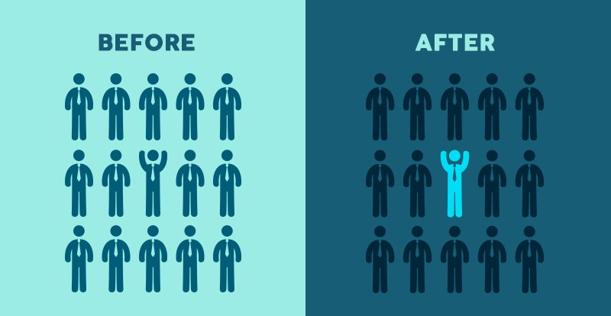
#3 Contrast: Draw Attention
1 slide = 1 important thing only
Use color, size to highlight the important thing

Slide 23
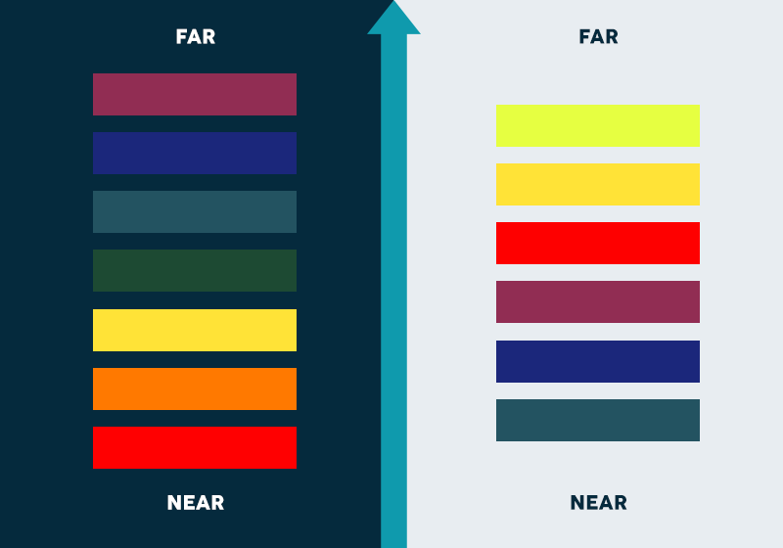
Tip - Contrast well the background and foreground

Slide 24
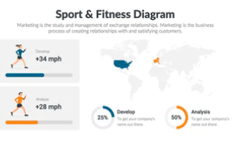
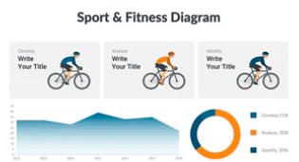
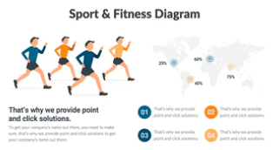
#4 Consistency : Same style everywhere !
Don't change your style from 1 style to another
Same
Fonts
Color
Components

Slide 25
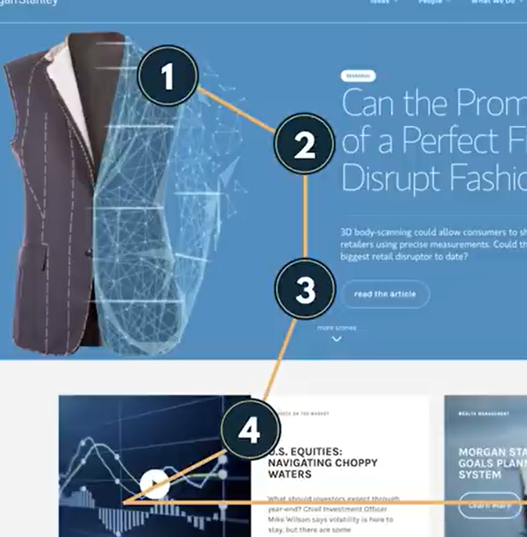
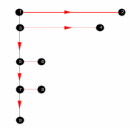
#5 Hierarchy : Follow the F pattern
What will you audience see first? second?
1
2
3
4

Slide 26




Small mistake on F pattern here
Good flow regarding the F pattern
1
1
?
2

Slide 27

#6 Layout : Use the rule of 3
Use the 3X3 grid to layout well your elements

Slide 28

#7 The rule of space
Maintain the spaces between lines, paragraphs, design elements…
Give breath to your design

Slide 29
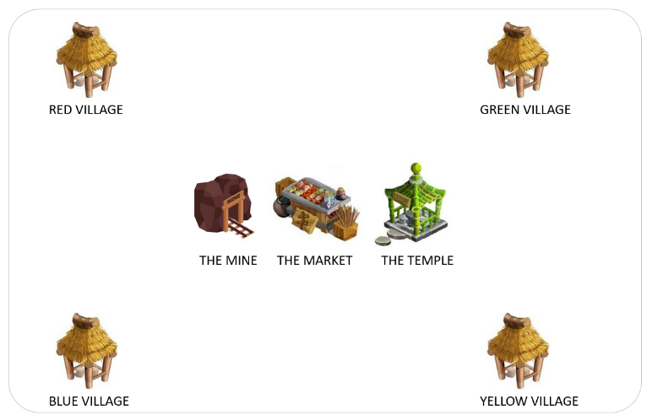


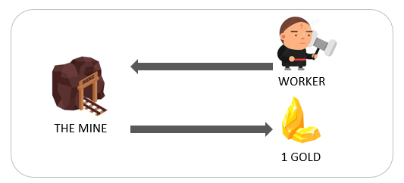
#8 1 slide = 1 idea only
THE WORKER
THE VILLAGE
The worker need to go to the mine and bring back golds to the village.
The more you have workers, the more you can get golds from the mine.
THE WORKER
The worker need to go to the mine and bring back golds to the village.
The more you have workers, the more you can get golds from the mine.

Slide 30
SUMMARY
Are you ready to apply the 8 rules ?
#1 Colors : 1 to 4 only
#5 Hierarchy : F pattern
#2 Fonts : 1 to 2 only
#6 Layout : Rule of 3
#3 Contrast: Draw Attention
#7 The rule of space
#4 Consistency : Same style
#8 1 slide = 1 idea only

Slide 31
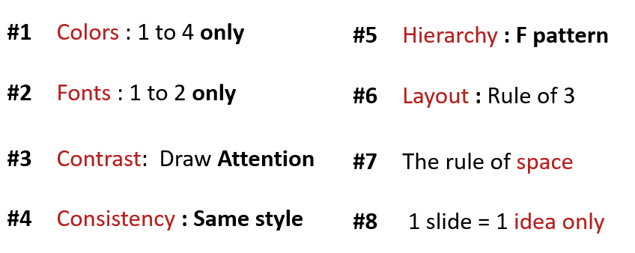

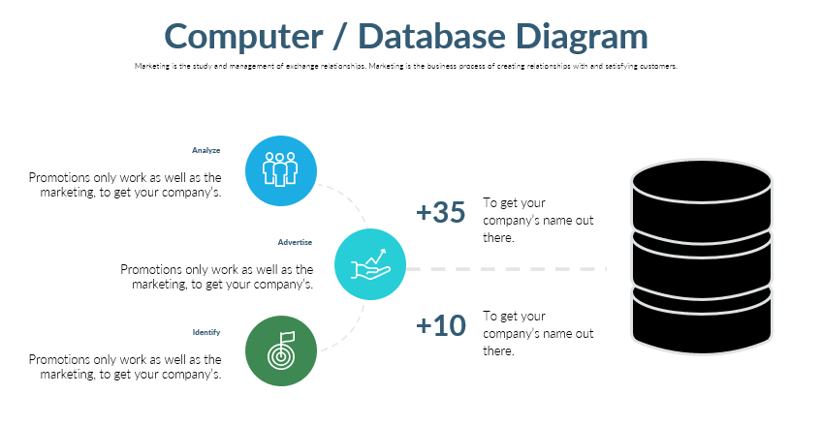
ACTIVITY
Let s work now !
Analyze the problems on 3 activities
Improve the slides if needed

Slide 32

FOR NEXT TIME
Watch the below 2 videos
https://drive.google.com/drive/folders/1kEWEqQGKujuCVrr3TSr6h-FvX2j0BsFA?usp=drive_fs
Submit the grid related to last exercise

